Slide 1
Software Project Management (SPM)
Introduction

Slide 2
Out line
What is SPM?
Why it is important?
What are the 4Ps of SPM (People, Product, Process and Project)?
What is the work product?
What are Triple Constraints of PM?
What are SPM Knowledge Areas?

Slide 3
Job Pattern of Software Company
Software development can be seen in two parts:
  Software Creation/Engineering
  Software Project Management

Slide 4
What is a Project?
A project is a temporary endeavor undertaken to create a unique product with defined start and end dates to achieve one or more objectives within the constraints of cost, schedule/time, and quality performance.
It is well-defined task, which is a collection of several operations done in order to achieve a goal .
Software project is complete procedure of software development using SDLC, in a specified period of time to achieve intended software product.

Slide 5
Attributes of projects
  unique purpose
  temporariness
  require resources, often from various areas
  should have a primary sponsor and/or customer
  involve uncertainty

Slide 6
Project Stakeholders
Stakeholders are the people involved in or affected by project activities
Stakeholders include
  the project sponsor and project team
  support staff
  customers
  users
  suppliers

Slide 7
Why do software projects fail?
Bad Communications
Poor schedule or resource Management (mismanagement)
Weak requirements definitions (leads to inadequate planning)
Inadequate planning, assumptions/expectation, risks, or resources
Use of new or unproven technologies/methods

Slide 8
Contt..
Managing multiple projects at once or multi-tasking resources
Scope creep or poor impact analysis
Lack of qualified resources
Programmers have poor habits and they don’t feel accountable for their work.
Defects are injected early but discovered late.

Slide 9
What Helps Projects Succeed?
  Executive support
  User involvement
  Experienced project manager
  Clear business objectives
  Minimized scope
  A manager should not assume that programming is more difficult or technical than design, testing or requirements engineering.

Slide 10
What is Project Management (PM)?
Project management is application of knowledge, skills, tools, and techniques to project activities in order to meet project requirements.
Project Management is the art of maximizing the probability that a project delivers its goals on Time, on Budget and at the required Quality.
Software project management is an art and science of planning and leading software projects.
It is a sub-discipline of PM in which software projects are planned, implemented, monitored and controlled.

Slide 11
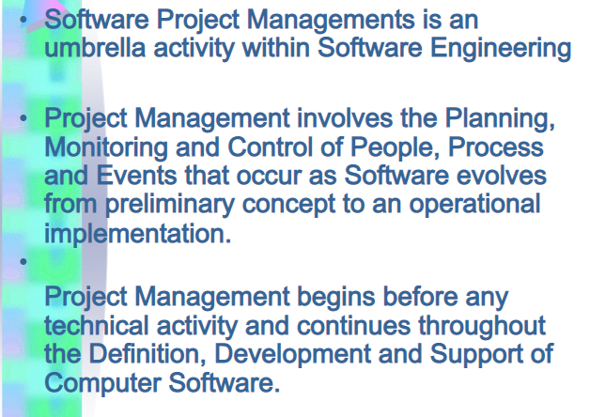
Contt…

Slide 12
Advantages of Using Formal SPM
  Better control of financial, physical, and human resources
  Improved customer relations
  Shorter development times
  Lower costs

Slide 13
Contt…
  Higher quality and increased reliability
  Higher profit margins
  Improved productivity
  Better internal coordination
  Higher worker morale

Slide 14
The Triple Constraint
  Every project is constrained in different ways by its
    Scope goals: What is the project trying to accomplish?
    Time goals: How long should it take to complete?
    Cost goals: What should it cost?
  It is the project manager’s duty to balance these three often competing goals

Slide 15
Software Project Manager
A software project manager is a person who undertakes the responsibility of executing the software project.
Project manager may never directly involve in producing the end product but he controls and manages the activities involved in production.
But, closely monitors the development process, prepares various plans, arranges necessary resources, maintains communication among all team members in order to address issues of cost, budget, resources, time, quality and customer satisfaction.

Slide 16
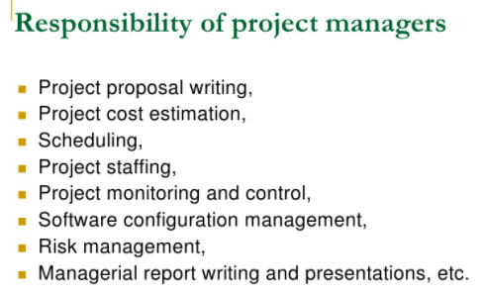
Contt..

Slide 17
Suggested Skills for a Project Manager
    Communication skills: listening, persuading,…
    Organizational skills: planning, analyzing,…
    Team Building skills: empathy, motivation, ….
    Leadership skills: set example, energetic, vision (big picture), delegates, positive,…
    Coping skills: flexibility, creativity, patience, persistence
    Technological skills: experience, project knowledge,….

Slide 18
4P’s of SPM
Essentially, 4P’s refers to four critically important elements of PM.
Embracing these elements in your project can help your team meet its goals and objectives. The four P’s are :
  1. People ( people who are play in PM includes project manager, project team members, sponsors, stakeholders, developers..)
  2. Product (As the name implies, this is the deliverable of the project)
  3. Process (select appropriate methodology or process model)
  4. Project (This is where the project manager’s roles and responsibilities come into play)

Slide 19
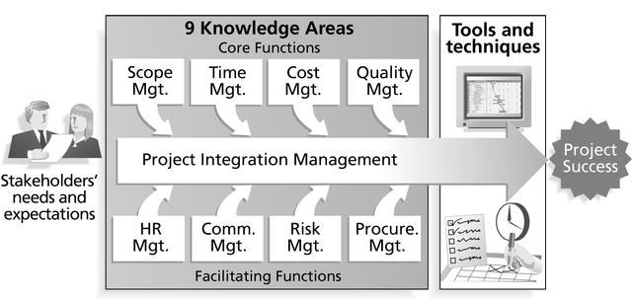
Project Management Framework

Slide 20
Project Management Knowledge Areas
9 Knowledge areas describe the key competencies that project managers must develop are:
  4 core knowledge areas lead to specific project objectives (scope, time, cost, and quality)
  4 facilitating knowledge areas are the means through which the project objectives are achieved (human resources, communication, risk, and procurement management).
  1 knowledge area (project integration management) affects and is affected by all of the other knowledge areas.

Slide 21
Need for Top Management Commitment
Several studies cite top management commitment as one of the key factors associated with project success.
Top management can help project managers secure adequate resources, get approval for unique project needs in a timely manner, receive cooperation from people throughout the organization, and learn how to be better leaders.

Slide 22
Project Management Life Cycle/Process Groups
Project management can be viewed as a number of interlinked processes and usually broken down into five phases.
These phases make up the path that takes your project from the beginning to the end. These are:
  Initiating processes
  Planning processes
  Executing processes
  Controlling processes
  Closing processes

Slide 23
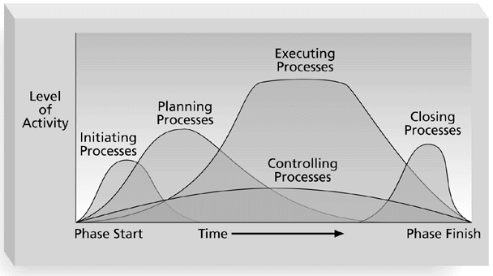
Overlap of Process Groups in a Phase

Slide 24
Project Management Tools and Techniques
Project management tools and techniques assist project managers and their teams in various aspects of project management.
Like:
  Project Charter and WBS (scope)
  Gantt charts, network diagrams, critical path analysis, critical chain scheduling (time)
  Cost estimates and earned value management (cost)

Slide 25
How Project Management (PM) Relates to Other Disciplines
Much of the knowledge needed to manage projects is unique to PM
However, project managers must also have knowledge and experience in
  general management
  the application area of the project
Project managers must focus on meeting specific project objectives

